Slide 1
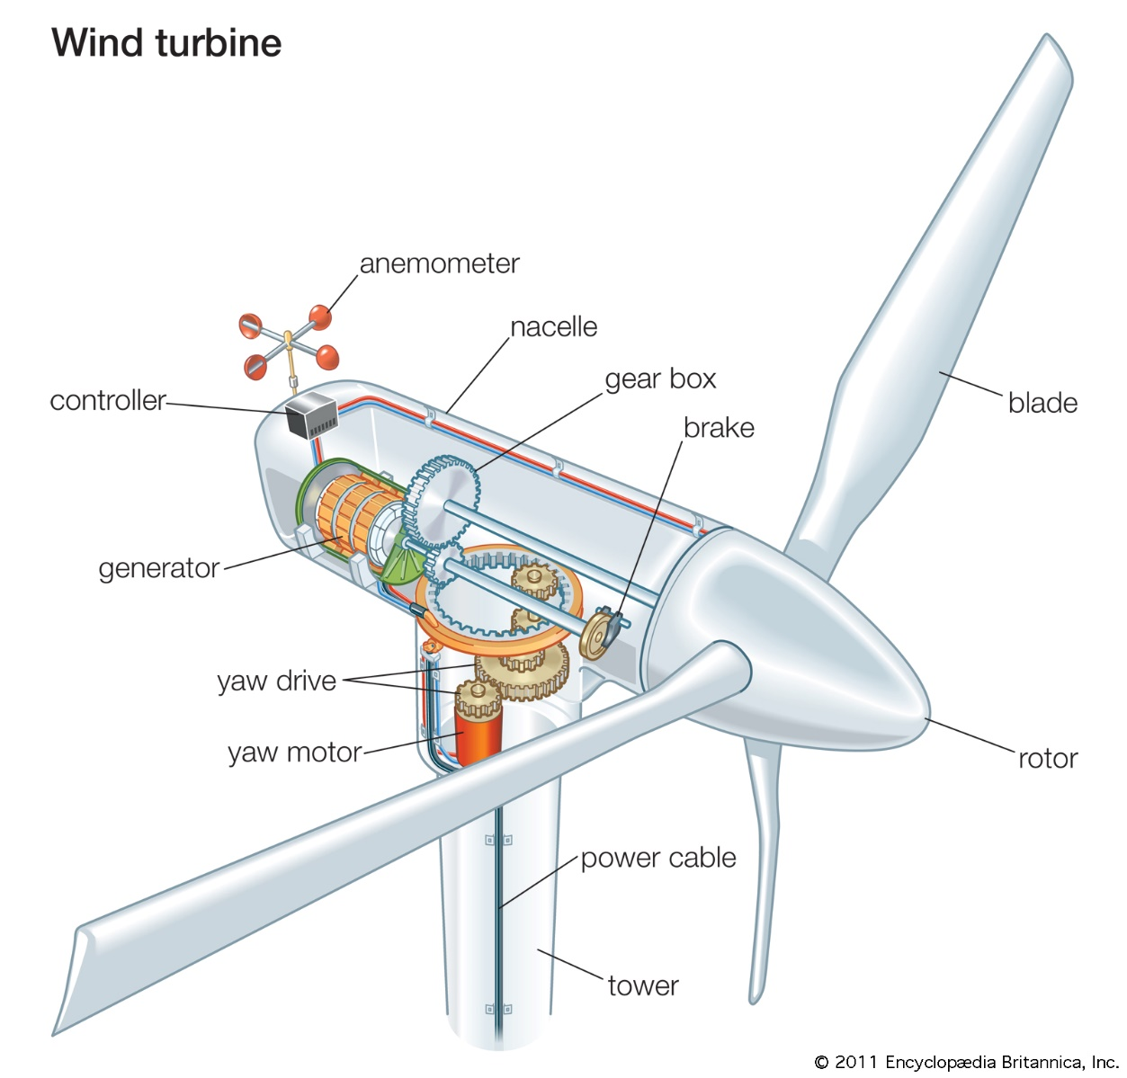





Know your Product – Predictive Maintenance Platform (PdM)
MANIKANDDAN GC
PDM Platforms failure model distribution, real value and our value proposition
Wind Turbine Failure Models
OEM 1 | OEM 2 | OEM 3 | OEM 4
60 | 60 | 65 | 70
2
1
Converter
11
Pitch
4
7
Extract Value (Quantifiable Real Value):
2
Bearings
Increased Component Lifetime
Reduced Downtime, Energy and Revenue Loss
4
2
8
Realise Value (Our Value Proposition):
PdM Platform is the gateway for Predictive Maintenance for Global Wind Turbines
Near-zero unplanned downtime
Guaranteed decrease in O&M cost
Reduced repair time
Maximised uptime
1
3
4
Pump
Other Monitors

Slide 2
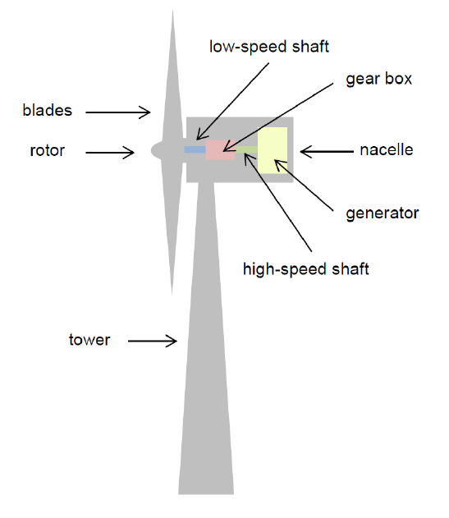










PdM Platform – Vision, Strategy & Roadmap
MANIKANDDAN GC
PdM Platform‘s future for continuous Retention and differentiation
VISION: Predictive maintenance of all components in wind turbine across Multibrand Fleet with 360 degree view of asset intelligence – analytics & insights and enable automated dispatching for the identified problem with right service technician with right spare parts
MONITORS for all Problems across Multibrand WTGs
Predictive Maintenance Platform for Wind Turbines
CORE SERVICES
AI/ML based Component Failure Prediction Engine
Insights Engine – Metrics, KPIs
Remedies and Recommendation Engine to fix the problem
Smart AI/ML based Auto Dispatching Engine
Integration Engine –
Work Order Data,
Service Technician Data,
Sparte Parts Data,
Other Ops Data
1
2
3
4
5
COMPONENTS & MONITORS
AIS | ALU Pumps | Anemometer | Bearings | Converter | CWE/ Software | Gearbox | Generator
Hydraulics | Pitch | Rotor | TCU | Yaw | Tower | Blades | Others
KEY FUNCTIONS
Immersive Dashboard with advanced Visualizations
Problem Analytics
PdM Insights
Reports

Slide 3
PdM Platform as standalone product to One Platform Strategy for Predictive Maintenance for all OEM Wind Turbines
MANIKANDDAN GC
Transformation roadmap for continuous Retention and differentiation
P
dM
Increase Problem Coverage by building Monitors – Existing Fleet
Phase 1 - Product Features – Integration Engine, Immersive Dashboards – Graphs, Charts, Visualizations, Advanced Analytics, Insights Engine
Phase 2 - Product Features – Remedies and Recommendations, On-Premise Deployment Option
Phase 2 - Product Features – Smart Dispatching Engine
Build Monitors for Multibrand Fleet
2021
2022
2023
2024
2025
One Platform for PdM, CMS, SHM and Blade Monitoring
Lifecycle Automation – Problems, Spares, Technicians
Lifecycle Optimization
ALL DIGITAL PRODUCTS IN ONE PLATFORM

